Slide 1








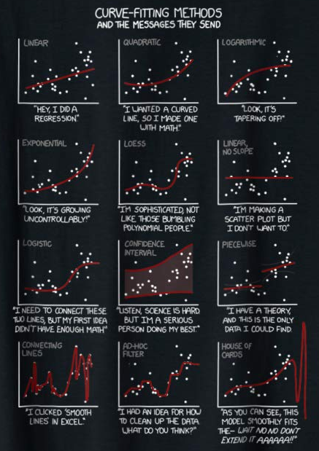


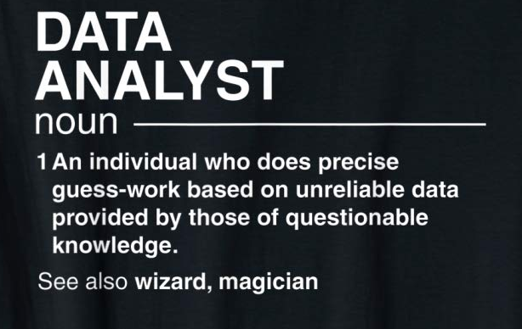
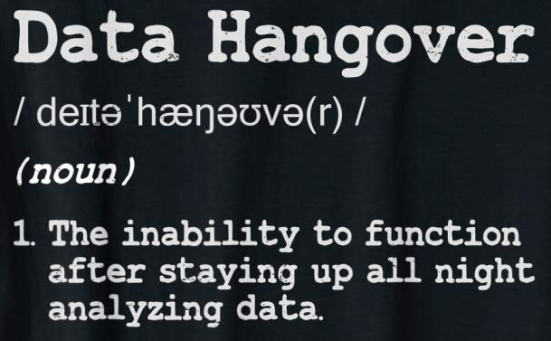


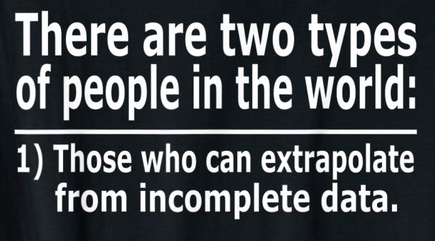









Slide 2
14
:
0
1
2
3
4
5
0
1
2
3
4
5
6
7
8
9
0
1
2
3
4
5
6
7
8
9
0
1
2
3
4
5
6
7
8
9
0
1
2
3
4
5
6
7
8
9
0
1
2
3
4
5
6
7
8
9
0
1
2
3
4
5
6
7
8
9

Slide 3
13
:
0
1
2
3
4
5
0
1
2
3
4
5
6
7
8
9
0
1
2
3
4
5
6
7
8
9
0
1
2
3
4
5
6
7
8
9
0
1
2
3
4
5
6
7
8
9
0
1
2
3
4
5
6
7
8
9
0
1
2
3
4
5
6
7
8
9

Slide 4
12
:
0
1
2
3
4
5
0
1
2
3
4
5
6
7
8
9
0
1
2
3
4
5
6
7
8
9
0
1
2
3
4
5
6
7
8
9
0
1
2
3
4
5
6
7
8
9
0
1
2
3
4
5
6
7
8
9
0
1
2
3
4
5
6
7
8
9

Slide 5
11
:
0
1
2
3
4
5
0
1
2
3
4
5
6
7
8
9
0
1
2
3
4
5
6
7
8
9
0
1
2
3
4
5
6
7
8
9
0
1
2
3
4
5
6
7
8
9
0
1
2
3
4
5
6
7
8
9
0
1
2
3
4
5
6
7
8
9

Slide 6
10
:
0
1
2
3
4
5
0
1
2
3
4
5
6
7
8
9
0
1
2
3
4
5
6
7
8
9
0
1
2
3
4
5
6
7
8
9
0
1
2
3
4
5
6
7
8
9
0
1
2
3
4
5
6
7
8
9
0
1
2
3
4
5
6
7
8
9

Slide 7
9
:
0
1
2
3
4
5
0
1
2
3
4
5
6
7
8
9
0
1
2
3
4
5
6
7
8
9
0
1
2
3
4
5
6
7
8
9
0
1
2
3
4
5
6
7
8
9
0
1
2
3
4
5
6
7
8
9
0
1
2
3
4
5
6
7
8
9

Slide 8
8
:
0
1
2
3
4
5
0
1
2
3
4
5
6
7
8
9
0
1
2
3
4
5
6
7
8
9
0
1
2
3
4
5
6
7
8
9
0
1
2
3
4
5
6
7
8
9
0
1
2
3
4
5
6
7
8
9
0
1
2
3
4
5
6
7
8
9

Slide 9
7
:
0
1
2
3
4
5
0
1
2
3
4
5
6
7
8
9
0
1
2
3
4
5
6
7
8
9
0
1
2
3
4
5
6
7
8
9
0
1
2
3
4
5
6
7
8
9
0
1
2
3
4
5
6
7
8
9
0
1
2
3
4
5
6
7
8
9

Slide 10
6
:
0
1
2
3
4
5
0
1
2
3
4
5
6
7
8
9
0
1
2
3
4
5
6
7
8
9
0
1
2
3
4
5
6
7
8
9
0
1
2
3
4
5
6
7
8
9
0
1
2
3
4
5
6
7
8
9
0
1
2
3
4
5
6
7
8
9

Slide 11
5
:
0
1
2
3
4
5
0
1
2
3
4
5
6
7
8
9
0
1
2
3
4
5
6
7
8
9
0
1
2
3
4
5
6
7
8
9
0
1
2
3
4
5
6
7
8
9
0
1
2
3
4
5
6
7
8
9
0
1
2
3
4
5
6
7
8
9

Slide 12
4
:
0
1
2
3
4
5
0
1
2
3
4
5
6
7
8
9
0
1
2
3
4
5
6
7
8
9
0
1
2
3
4
5
6
7
8
9
0
1
2
3
4
5
6
7
8
9
0
1
2
3
4
5
6
7
8
9
0
1
2
3
4
5
6
7
8
9

Slide 13
3
:
0
1
2
3
4
5
0
1
2
3
4
5
6
7
8
9
0
1
2
3
4
5
6
7
8
9
0
1
2
3
4
5
6
7
8
9
0
1
2
3
4
5
6
7
8
9
0
1
2
3
4
5
6
7
8
9
0
1
2
3
4
5
6
7
8
9

Slide 14
2
:
0
1
2
3
4
5
0
1
2
3
4
5
6
7
8
9
0
1
2
3
4
5
6
7
8
9
0
1
2
3
4
5
6
7
8
9
0
1
2
3
4
5
6
7
8
9
0
1
2
3
4
5
6
7
8
9
0
1
2
3
4
5
6
7
8
9

Slide 15
1
:
0
1
2
3
4
5
0
1
2
3
4
5
6
7
8
9
0
1
2
3
4
5
6
7
8
9
0
1
2
3
4
5
6
7
8
9
0
1
2
3
4
5
6
7
8
9
0
1
2
3
4
5
6
7
8
9
0
1
2
3
4
5
6
7
8
9

Slide 16
Let’s Go!
0
:
0
1
2
3
4
5
0
1
2
3
4
5
6
7
8
9
0
1
2
3
4
5
6
7
8
9
0
1
2
3
4
5
6
7
8
9
0
1
2
3
4
5
6
7
8
9
0
1
2
3
4
5
6
7
8
9
0
1
2
3
4
5
6
7
8
9

Slide 17
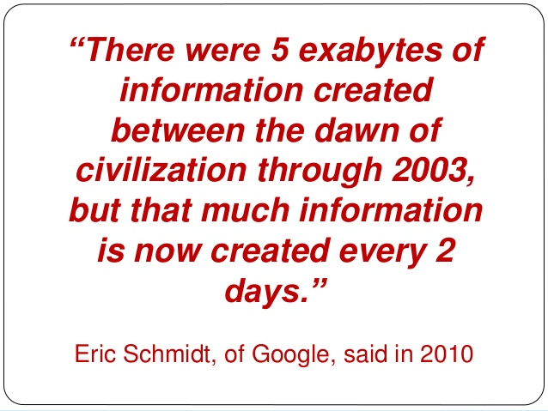
Notes:
5 exabytes = 5 billion gigabytes
Standard computer is 500 GB
That’s 10M computers…or a stack of hard drives that would reach the Internation Space Station

Slide 18
“Over the last two years alone 90 percent of the data in the world was generated”
-Forbes 2018

Slide 20
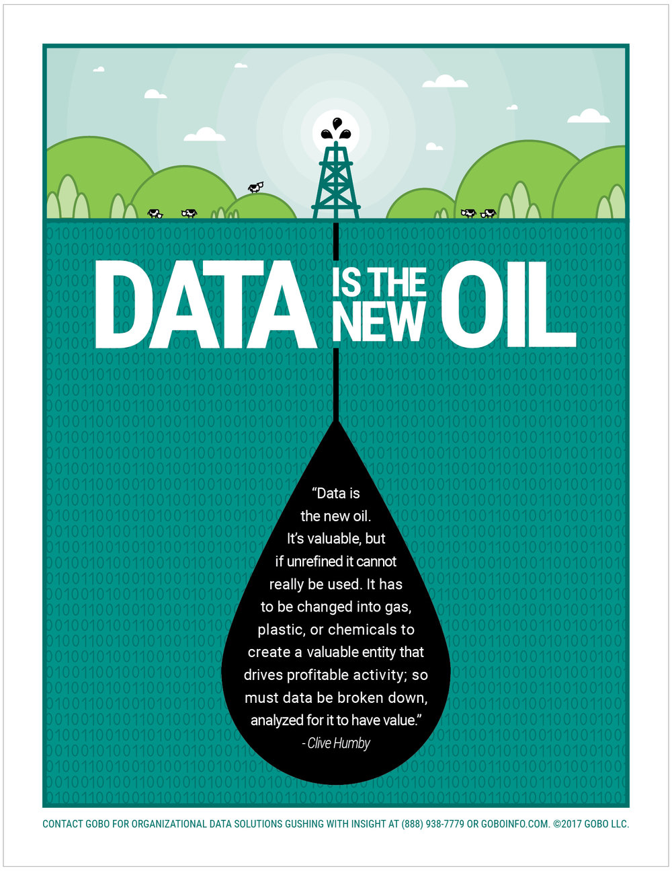

Slide 21


Slide 22
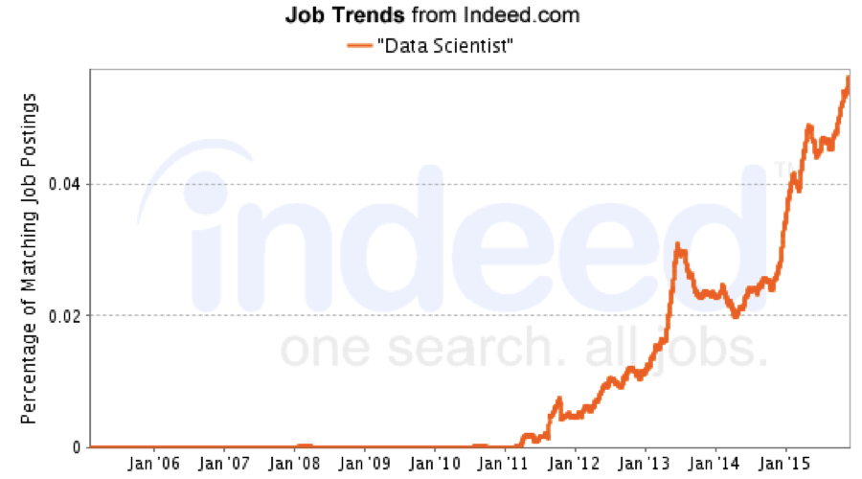

Slide 23
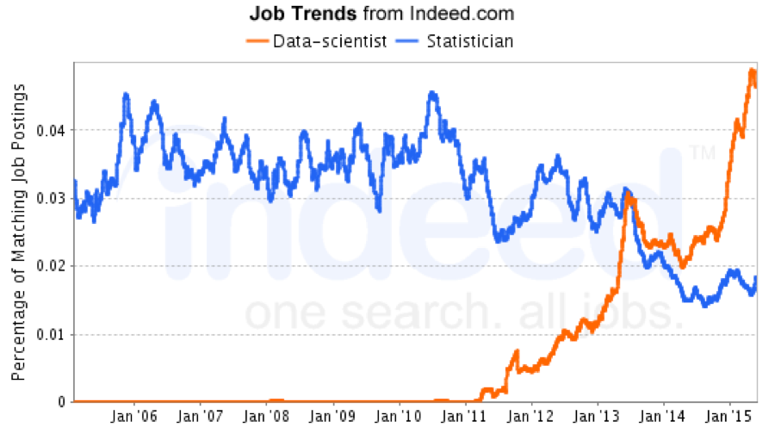

Slide 24
AI
Data Producer
Machine Learning
Data Scientist
Data Manager
DBA
Do Something
Predict Something
Learn Something
Store Something
Measure Something

Slide 25
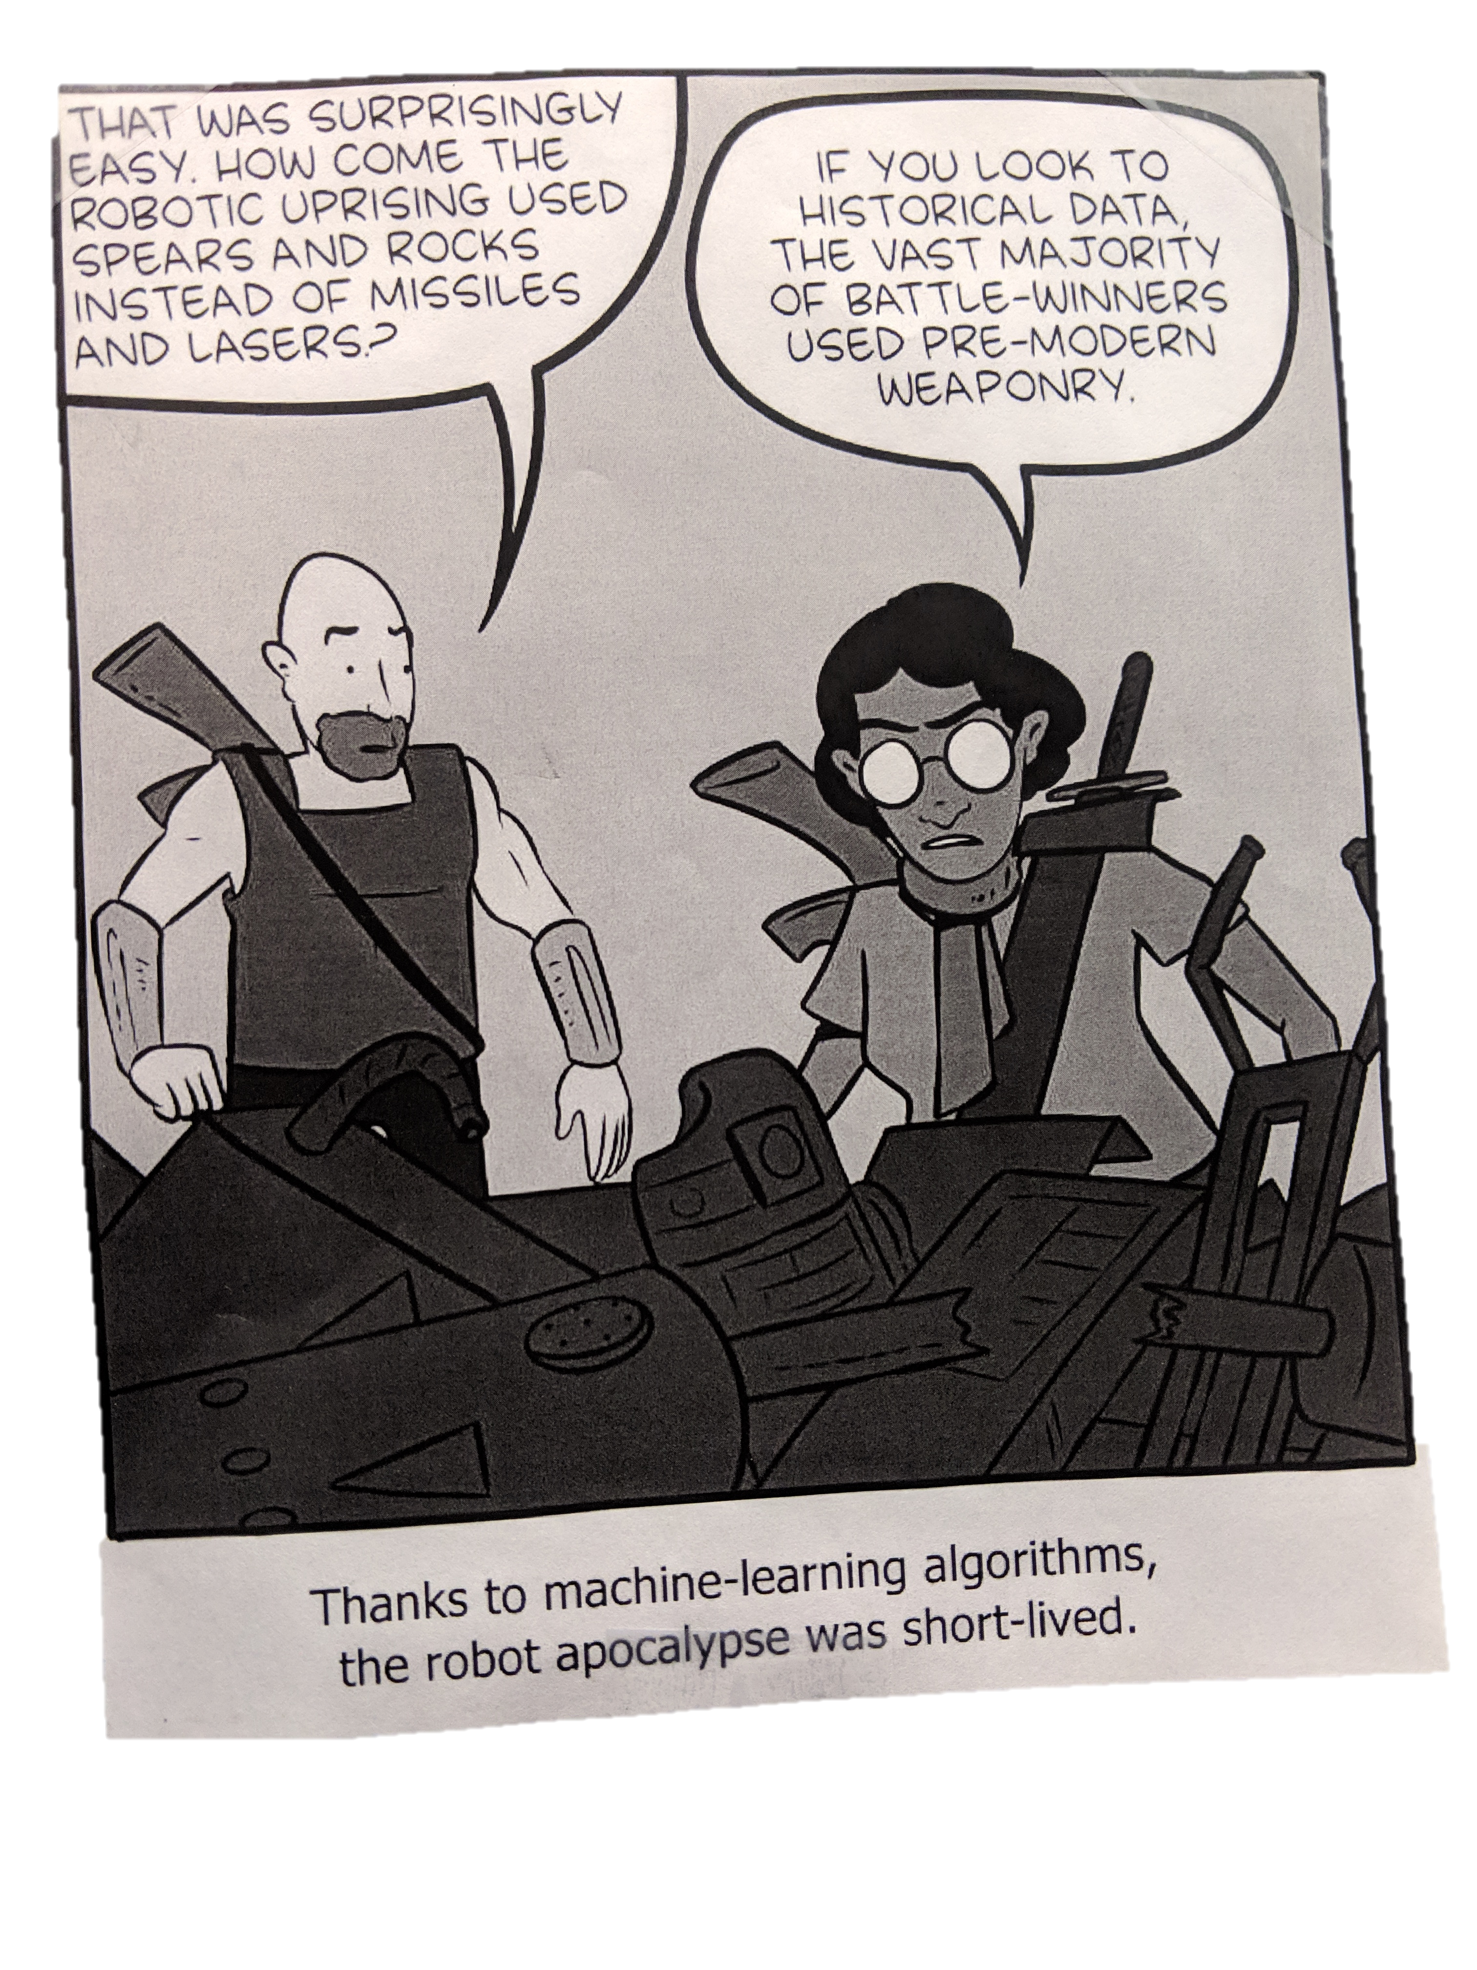

Slide 26
Don’t Be A
Correlation
Casualty
Notes:
www.governing.com 4 Reasons Data Analytics Often Fail
The Chicago Police Department thought it had a fail-proof strategy for keeping a lid on violent crime: a heat map of the 400 individuals most likely to break the law. The index of violent individuals was the result of a predictive analytics program that used a mathematical algorithm to sift through crime data. It worked much like the analytics programs Netflix or Amazon use to predict a person’s next movie rental or book purchase.
But the algorithm ran into a firestorm of controversy in late 2013 when a Chicago Tribunearticle told the story of a man on the list who had no criminal arrests. While the police defended the tool, critics said it was nothing more than racial profil
First, there are misconceptions about analytics. It’s not a technology project that should be run by the IT department, though it will need input from CIOs and their staff to manage the databases and networks that underpin it. It’s also not about data. Rather, it’s a way to predict future strategies and support decision-making. That’s why the right stakeholders need to be involved.ing. They compared to it to a bad version of Minority Report, the popular sci-fi film about police who predict crimes before they happen.

Slide 27
“The industries that use ML are slowly learning that the data used to train ML systems must be as unbiased and trusted as the systems themselves need to be…”
MIT Task Force on the Work of the Future, 2019

Slide 28
“… analytic projects fail when the data quality is inferior. Bad data creates poor results.”
4 Reasons Data Analytics Often Fail
www.governing.com
Notes:
Second, analytic projects fail when the data quality is inferior. Bad data creates poor results. Lack of data sharing can also hobble the best planned analytics project. While there are technical barriers to data sharing, too often the problem is an unwillingness to share between agencies or departments. The result is turf battles that erupt when one agency wants to protect the data they’ve collected.

Slide 29
AI
Data Producer
Machine Learning
Data Scientist
Data Manager
DBA
Do Something
Predict Something
Learn Something
Store Something
Measure Something

Slide 30
AI
Data Producer
Machine Learning
Data Scientist
Data Manager
DBA
Do Something
Predict Something
Learn Something
Store Something
Measure Something

Slide 31


Slide 32

Name
Affiliation
Show Me The Data!
What Fish Would You Be?

Slide 33




Slide 34

Care
And
Feeding
Of The
Data
Monster

Slide 35


Slide 36
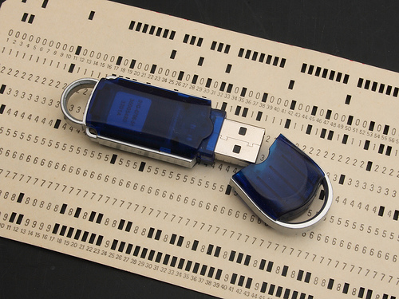
Notes:
Computing Resources have come a long ways.
GUI’s change, but underlying data is universal

Slide 37
What are data skills?

Slide 38
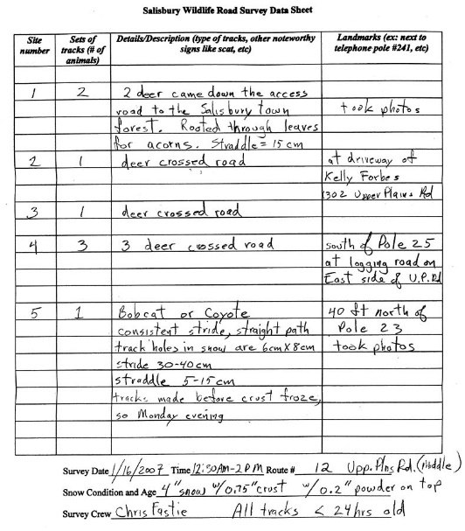

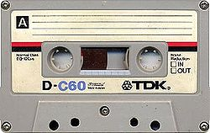
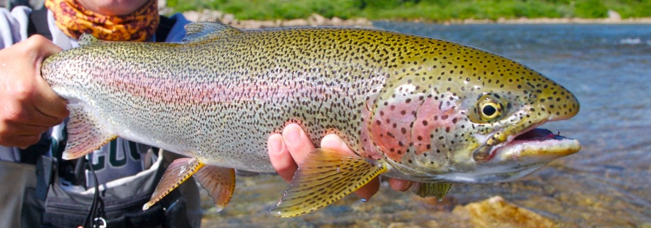

What is data?

Slide 39
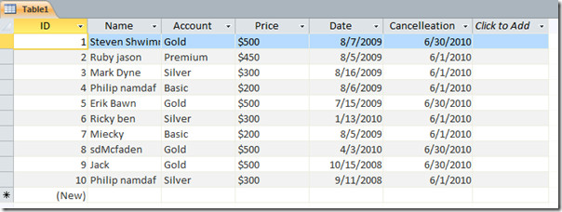
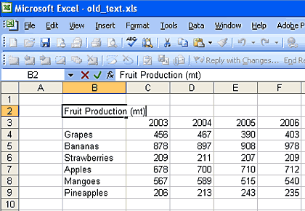
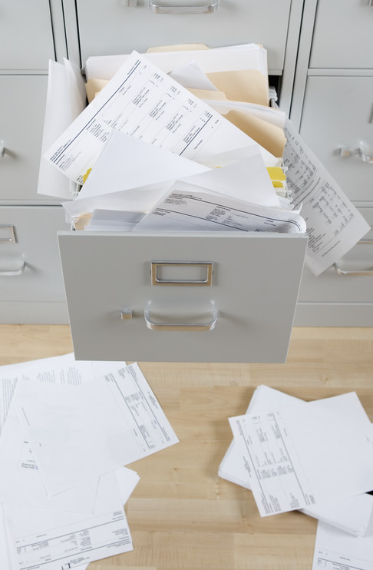
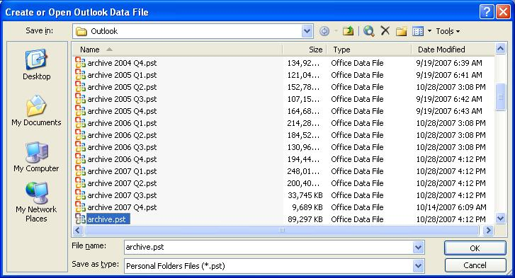
What is a datastore?

Slide 40
What is a database?

Slide 41

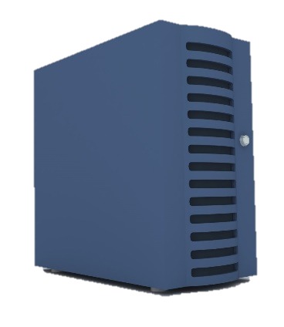
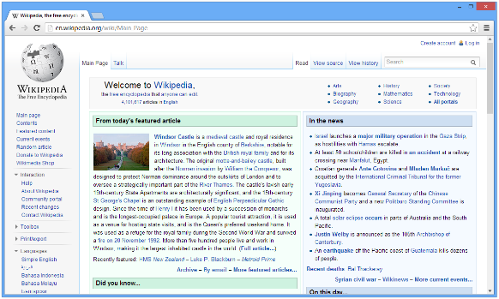

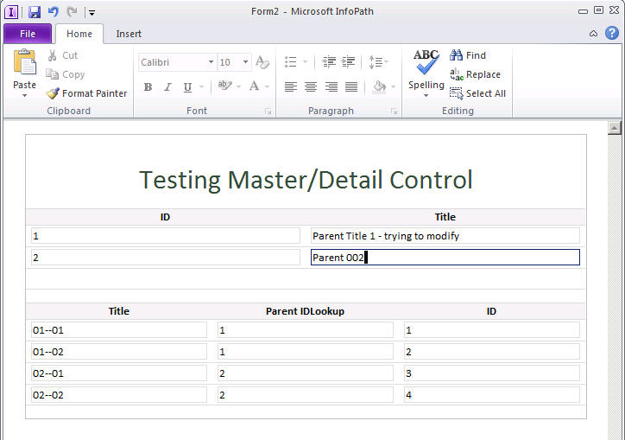



What is a data system?

Slide 42
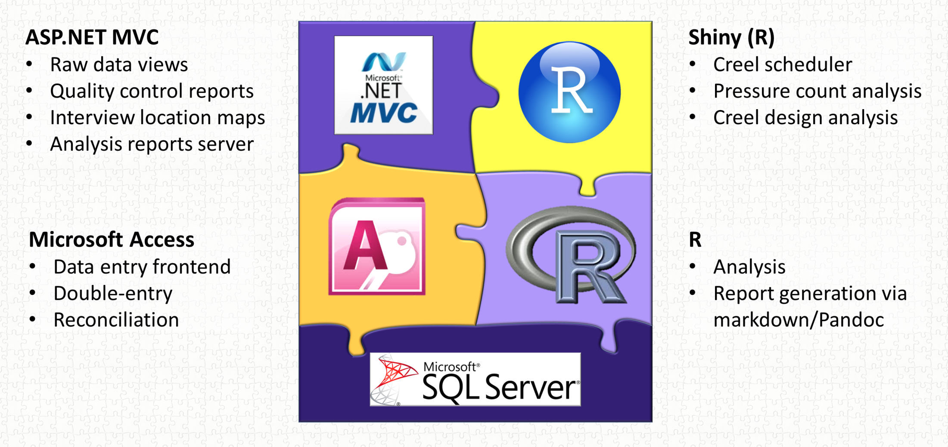
What is a data system?

Slide 43



Slide 44
Data Management
Data Tools
Designing A Relational Database
Using Microsoft Access

Slide 45

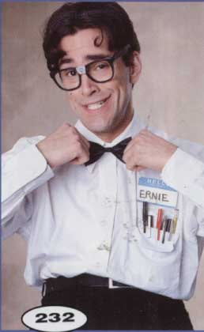
Welcome
To The World
Of The Geek
Data
Management
Notes:
Actually…normally more reminiscent of engineers than geeks. There’s always some truth to all stereotypes, so what about the geek represents good qualities of data managers?
Retentive nature, same way-every time, accept menial repetitive tasks as the cost of business…..
This gives us a nice framework for thinking about data management.

Slide 46
Why is data management important to me?
Save Time!
Save Money!
No data…….no money
No data……no thesis
No data……no publications
Set yourself apart

Slide 47
Why is data management important to me?
Save Time!
Save Money!
No data…….no money
No data……no thesis
No data……no publications
Set yourself apart

Slide 48
Why is data management important to me?
Save Time!
Save Money!
No data…….no money
No data……no thesis
No data……no publications
Set yourself apart

Slide 49
Why is data management important to me?
Save Time!
Save Money!
No data…….no money
No data……no thesis
No data……no publications
Set yourself apart

Slide 50
Why is data management important to me?
Save Time!
Save Money!
No data…….no money
No data……no thesis
No data……no publications
Set yourself apart

Slide 51

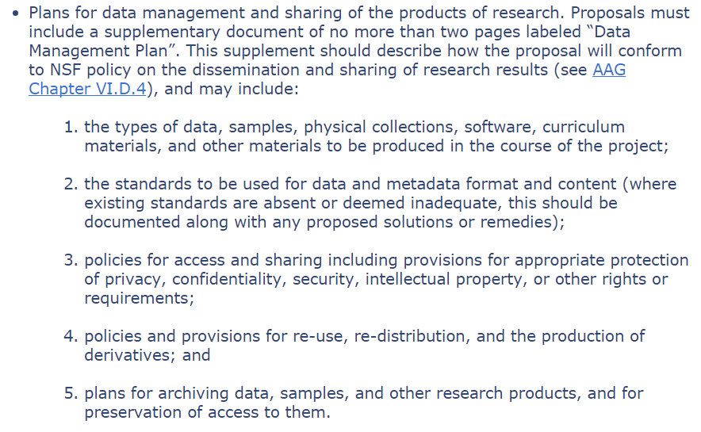

Slide 52
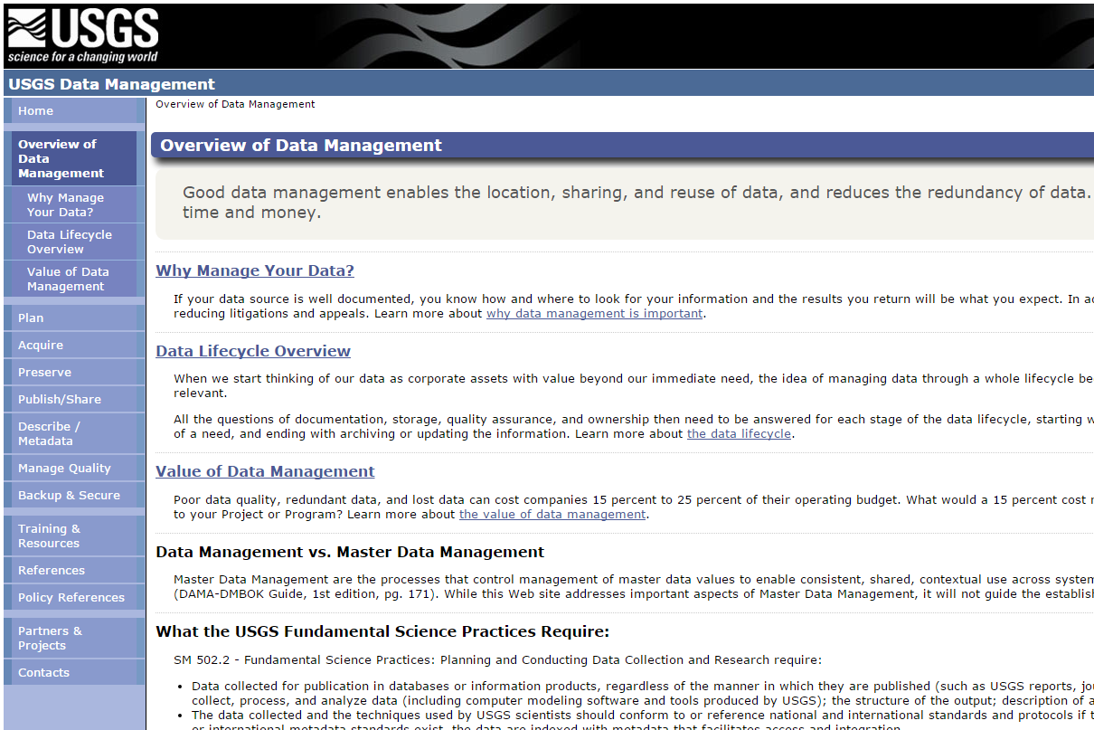

Slide 53
Data Management
"Data Resource Management is the development and execution of architectures, policies, practices and procedures that properly manage the full data lifecycle needs of an enterprise.“
– DAMA International

Slide 54
Data Management
“Use of policies and procedures to protect and efficiently use information.“
– Keith Hurley

Slide 55
Data Management
“Use of policies and procedures to protect and efficiently use information.“
– Keith Hurley

Slide 56


Slide 57

Consistency
Detail
Redundancy
Notes:
Actually…normally more reminiscent of engineers than geeks. There’s always some truth to all stereotypes, so what about the geek represents good qualities of data managers?
Retentive nature, same way-every time, accept menial repetitive tasks as the cost of business…..
This gives us a nice framework for thinking about data management.

Slide 58
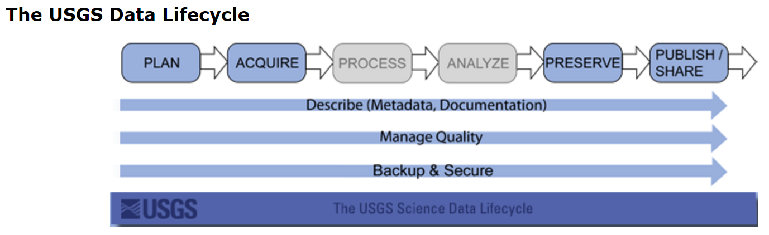
Data Lifecycle

Slide 59

Data Lifecycle
Field/Lab
Data Entry
Active/Analysis
Archive

Slide 60
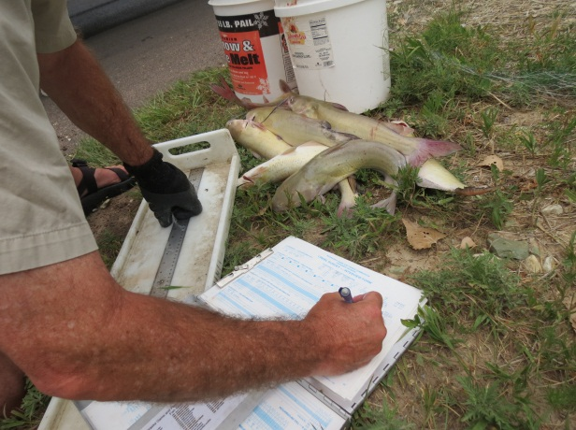
Field/Lab
Notes:
Layout
Units
Conversions/Codes
Waterproof
Self-explanitory
Visual Cues For Necessary Information
Methods to detect missing samples

Slide 61
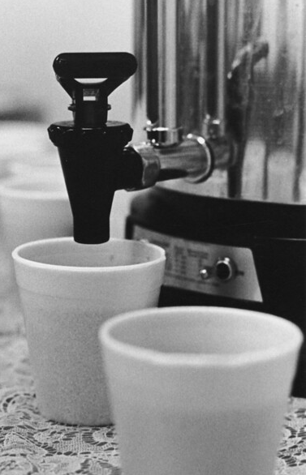
Break
15 Minutes
10 Minutes
5 Minutes

Slide 62
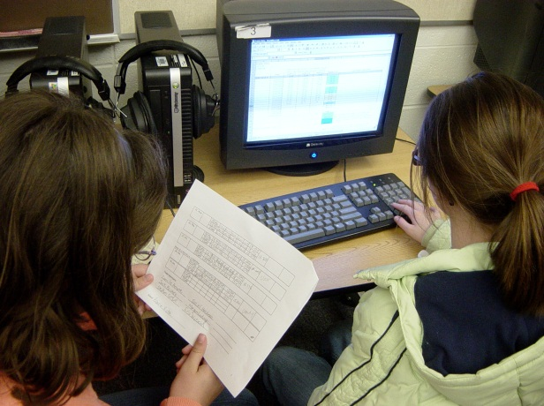
Data Entry
Notes:
Detect entry errors
Validation
Backup
Speed

Slide 63
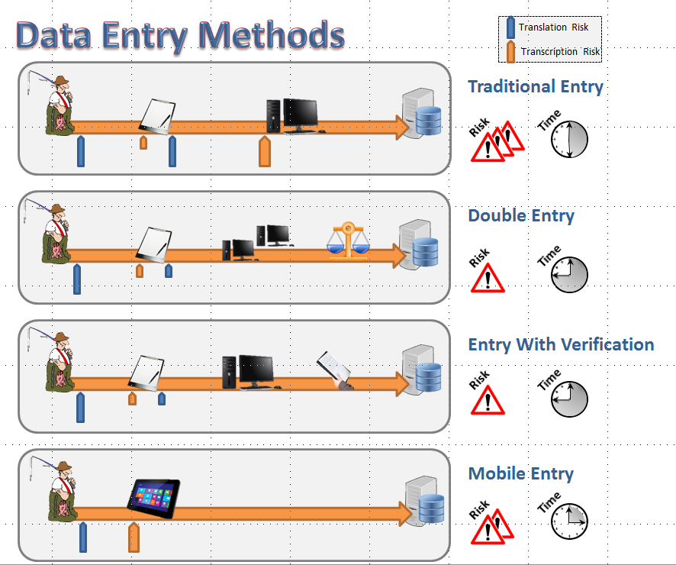
Notes:
Detect entry errors
Validation
Backup
Speed

Slide 64
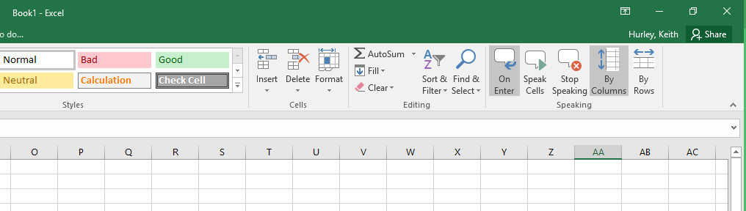

Slide 65
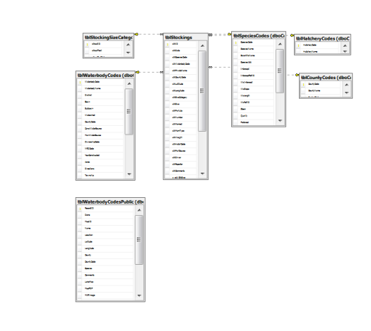
Active / Analysis

Slide 66

Archive
Notes:
Detect entry errors
Validation
Backup
Speed

Slide 67
Data Management
Field
Lab
Active/Analysis
Archive

Slide 68
Important Questions
Who can modify data?
Who can delete data?
Who can view data?
Who can use data?

Slide 69
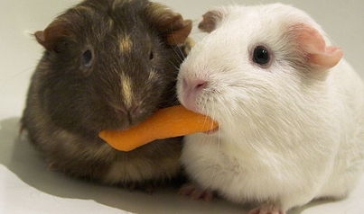
When data is available,
people WILL seek to use it!

Slide 70
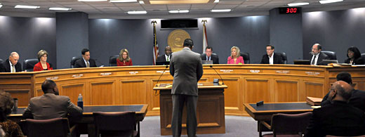

Slide 71
Break
15 Minutes
10 Minutes
5 Minutes

Slide 72






Databases
Notes:
Store and Retrieve Data
In our case tabular data

Slide 73




Notes:
Store and Retrieve Data
In our case tabular data

Slide 74




Slide 75

Flat Files

Slide 76

Flat Files
Spreadsheets

Slide 77
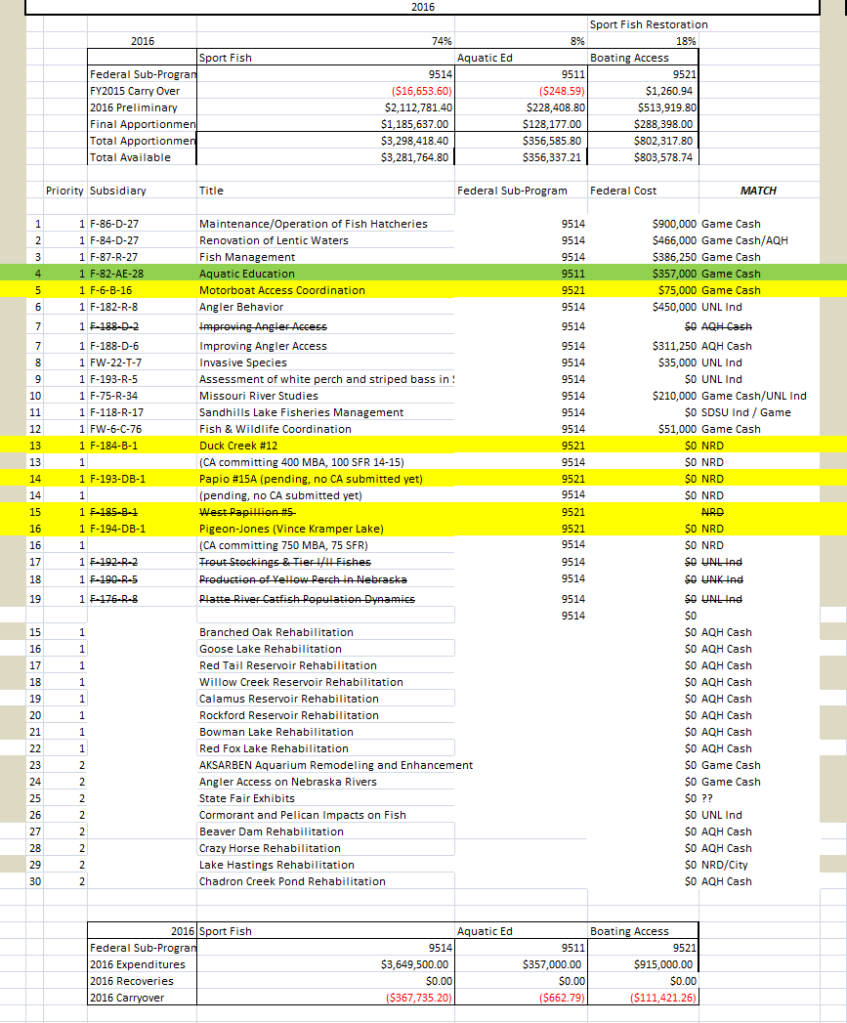
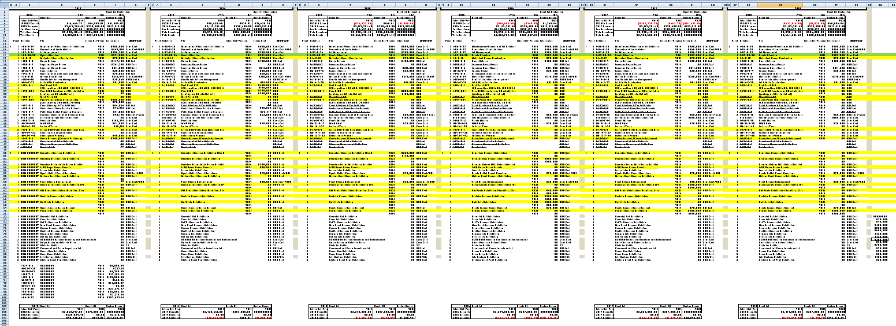

Slide 79


Slide 80


Slide 81
Do Not Use Spreadsheets

Slide 82

Flat Files
Spreadsheets
Statistical

Slide 83
Flat Files
Spreadsheets
Statistical
Non-Relational Databases

Slide 84



Flat Files
Spreadsheets
Statistical
Relational DB
Non-Relational Databases

Slide 85
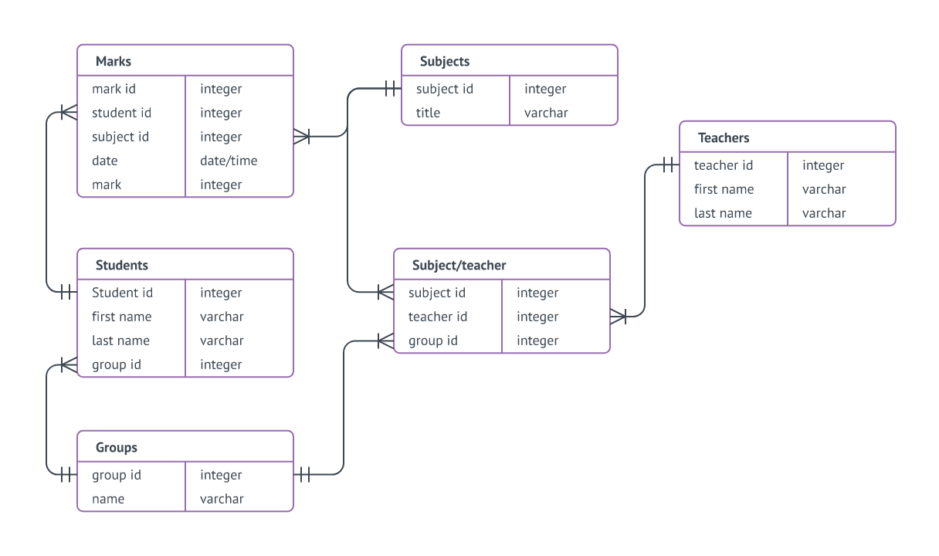
What is a relational database?
Notes:
Cascading updates and deletes to handle orphans and changes
Single point to change repeating values
Data has a “model” that relates to what it represents
Most are built around SQL language

Slide 86

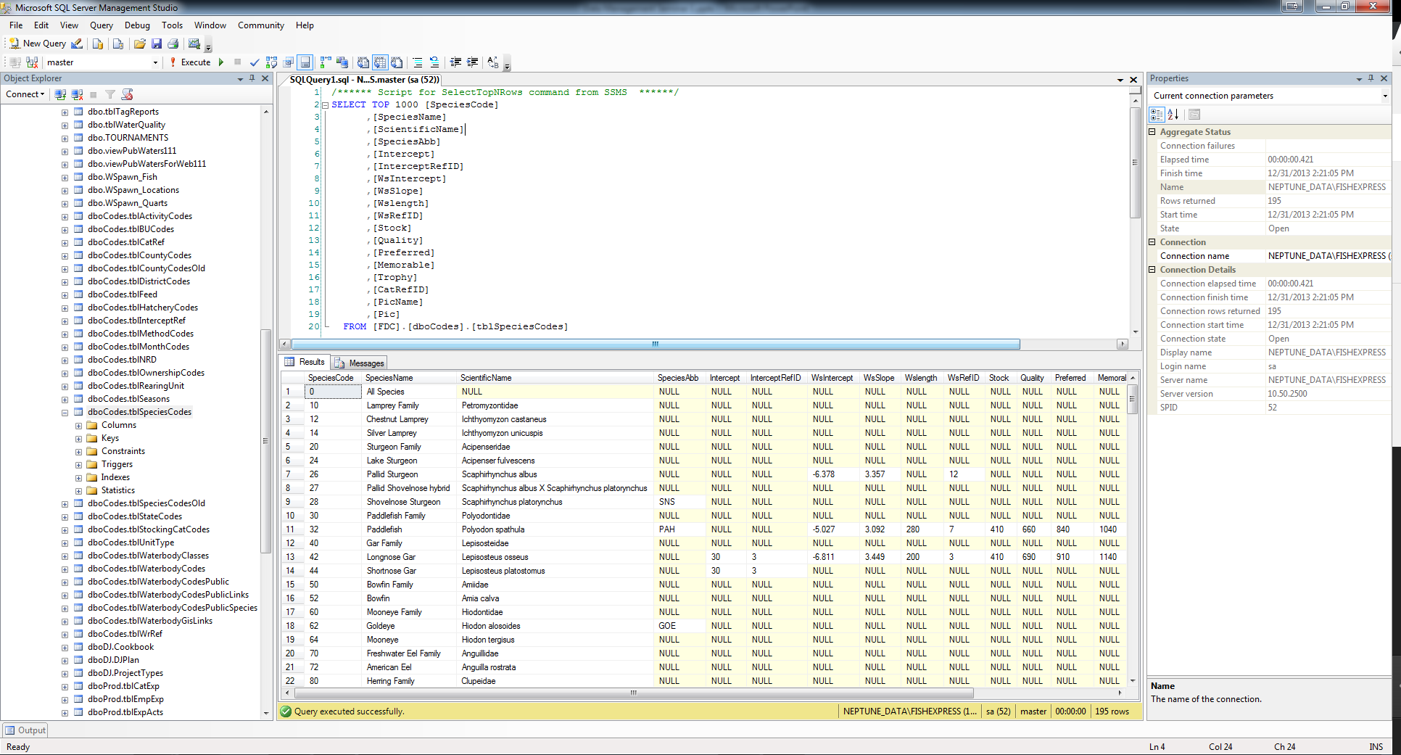
Stores Data
Runs Queries (Batch Operations)
Retrieves Data
Notes:
Can be on server or local computer
Mainly syntax (query) based
Views/Sprocs/Triggers
No real data entry capabilities
Only functional analysis capabilities

Slide 87
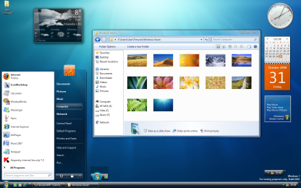
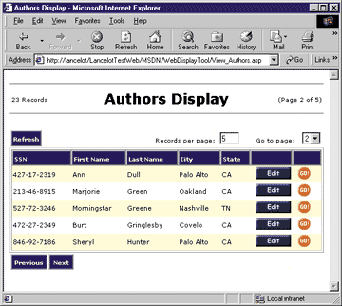
Stores Data
Runs Queries (Batch Operations)
Retrieves Data
Enter Data
Edit Data
Reports
Analysis
Enter Data
Edit Data
Reports
Analysis
Reports
Analysis

Slide 88

Enter Data
Edit Data
Reports
Analysis
Stores Data
Runs Queries (Batch Operations)
Retrieves Data
Reports
Analysis

Slide 89
Tables
Queries
Forms
Forms
Forms
Forms
Notes:
What do you lose with access………views, stored procedures, triggers, multi-user issues

Slide 90
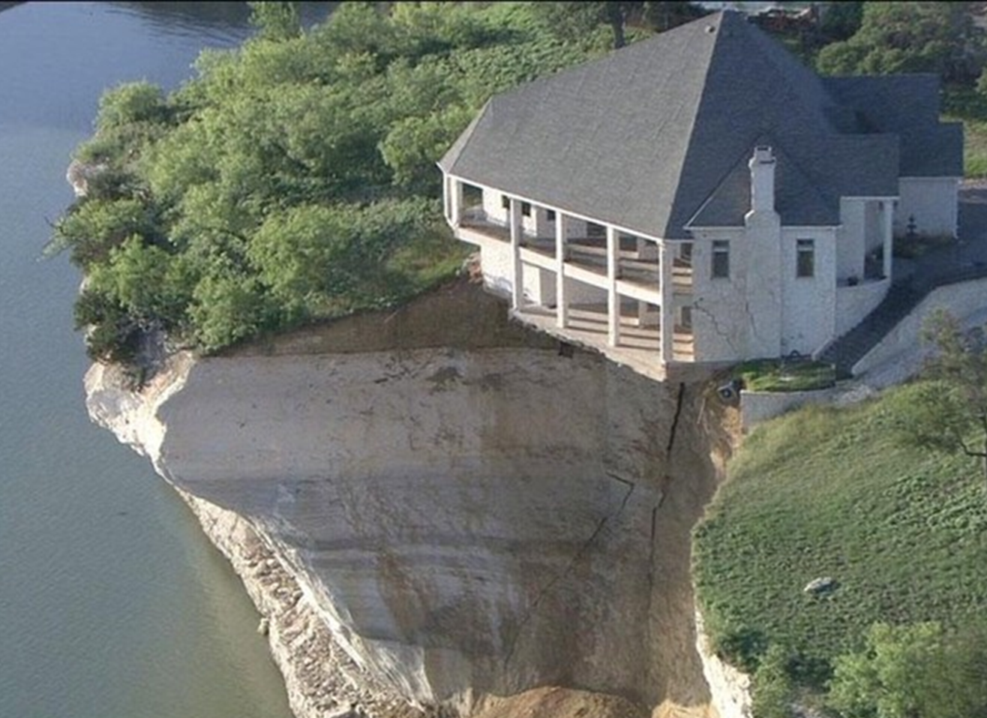
Designing
A
Database
Notes:
Use access to show how to design a database
Good design means
simpler queries
better performance
less data entry
easier to add data fields without breaking backwards compatibility
Think of records as an “entity”…and then “sets” of entities”

Slide 91

D’oh
Hurley’s Lessons Learned
Does history matter?
Delete or Deactivate?
Define the difference between null and zero
Every record gets its own identifier
Avoid text variables….PERIOD
Naming conventions

Slide 92
tblNets
tblFish
qryDates
net_UID
net_Date
net_Type
net_MeshSize
fsh_UID
fsh_netUID
fsh_Species
fsh_Length
fsh_Weight
net_UID
net_Date
fsh_UID
fsh_netUID
fsh_species

Slide 93
To Do
Create Lookup Tables To Remove Text
Split Out Sets Of Fields That Repeat Down Columns
Transpose columns to rows where possible
Goals
Each row represents one and only one piece of meaningful data
Each piece of data is in only one place
No data is in field headers
In production, you can add rows and not columns

Slide 94
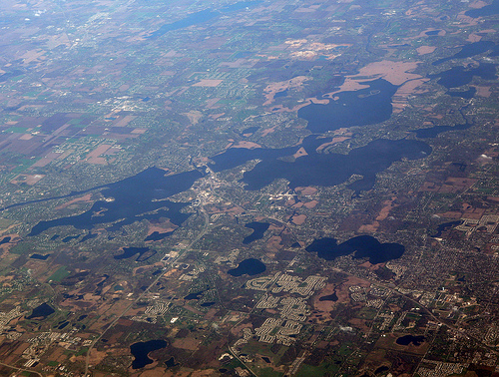
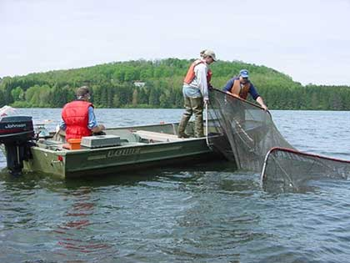
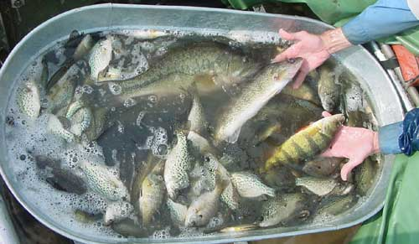
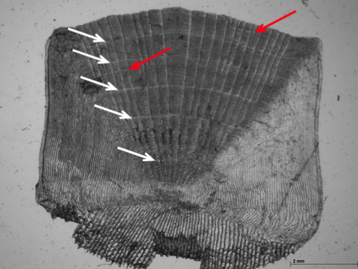
Notes:
Cascading updates and deletes to handle orphans and changes
Single point to change repeating values
Data has a “model” that relates to what it represents
Most are built around SQL language

Slide 95
date | lake | site | gear | species | length | weight | age | a1 | a2 | a3 | a4 | edge
06/01/13 | Round | Loon Point | Trap Net | bluegill | 210 | 254 | 4 | 178 | 223 | 381 | 413 | 413
06/01/13 | Round | Loon Point | Trap Net | bluegill | 243 | 222 | 4 | 145 | 242 | 335 | 481 | 490
06/01/13 | Round | Pintail Bay | Trap Net | bluegill | 135 | 86 | 2 | 195 | 284 |  |  | 292
06/01/13 | Round | West end of dam | Trap Net | redear | 142
06/25/13 | Round | Loon Point | Trap Net | black bullhead | 138
06/25/13 | Round | Pintail Bay | Trap Net | black bullhead | 179
06/25/13 | Round | Big Creek mouth | Trap Net | bluegill | 198 | 168 | 3 | 188 | 254 | 365 |  | 365
08/30/13 | Square | Mallard Cove | Gill Net | walleye | 854 | 355 | 4 | 113 | 241 | 384 | 476 | 484
08/30/13 | Square | Whitetail Point | Gill Net | walleye | 686 | 321 | 3 | 105 | 289 | 349 |  | 349
08/30/13 | Square | Bobber Bay | Gill Net | white bass | 312 | 211 |  |  |  |  |  | 230

Slide 96
date | lake | site | gear | species | length | weight | age | a1 | a2 | a3 | a4 | edge
06/01/13 | Round | Loon Point | 1 | 1 | 210 | 254 | 4 | 178 | 223 | 381 | 413 | 413
06/01/13 | Round | Loon Point | 1 | 1 | 243 | 222 | 4 | 145 | 242 | 335 | 481 | 490
06/01/13 | Round | Pintail Bay | 1 | 1 | 135 | 86 | 2 | 195 | 284 |  |  | 292
06/01/13 | Round | West end of dam | 1 | 2 | 142
06/25/13 | Round | Loon Point | 1 | 3 | 138
06/25/13 | Round | Pintail Bay | 1 | 3 | 179
06/25/13 | Round | Big Creek mouth | 1 | 1 | 198 | 168 | 3 | 188 | 254 | 365 |  | 365
08/30/13 | Square | Mallard Cove | 2 | 4 | 854 | 355 | 4 | 113 | 241 | 384 | 476 | 484
08/30/13 | Square | Whitetail Point | 2 | 4 | 686 | 321 | 3 | 105 | 289 | 349 |  | 349
08/30/13 | Square | Bobber Bay | 2 | 5 | 312 | 211 |  |  |  |  |  | 230
tblSpecies
spp_UID | spp_Name
1 | bluegill
2 | redear
3 | black bullhead
4 | walleye
5 | white bass
tblGears
gear_UID | gear_Name
1 | Trap Net
2 | Gill Net

Slide 97
date | site | gear | species | length | weight | age | a1 | a2 | a3 | a4 | edge
06/01/13 | 1 | 1 | 1 | 210 | 254 | 4 | 178 | 223 | 381 | 413 | 413
06/01/13 | 1 | 1 | 1 | 243 | 222 | 4 | 145 | 242 | 335 | 481 | 490
06/01/13 | 2 | 1 | 1 | 135 | 86 | 2 | 195 | 284 |  |  | 292
06/01/13 | 3 | 1 | 2 | 142
06/25/13 | 1 | 1 | 3 | 138
06/25/13 | 2 | 1 | 3 | 179
06/25/13 | 4 | 1 | 1 | 198 | 168 | 3 | 188 | 254 | 365 |  | 365
08/30/13 | 5 | 2 | 4 | 854 | 355 | 4 | 113 | 241 | 384 | 476 | 484
08/30/13 | 6 | 2 | 4 | 686 | 321 | 3 | 105 | 289 | 349 |  | 349
08/30/13 | 7 | 2 | 5 | 312 | 211 |  |  |  |  |  | 230
tblSites
site_UID | Site_lakeUID | site_Name
1 | 1 | Loon Point
2 | 1 | Pintail Bay
3 | 1 | West end of dam
4 | 1 | Big Creek mouth
5 | 2 | Mallard Cove
6 | 2 | Whitetail Point
7 | 2 | Bobber Bay
tblSpecies
spp_UID | spp_Name
1 | bluegill
2 | redear
3 | black bullhead
4 | walleye
5 | white bass
tblLakes
lake_UID | lake_Name
1 | Round
2 | Square
tblGears
gear_UID | gear_Name
1 | Trap Net
2 | Gill Net

Slide 98
date | site | gear | species | length | weight | age | a1 | a2 | a3 | a4 | edge
06/01/13 | 1 | 1 | 1 | 210 | 254 | 4 | 178 | 223 | 381 | 413 | 413
06/01/13 | 1 | 1 | 1 | 243 | 222 | 4 | 145 | 242 | 335 | 481 | 490
06/01/13 | 2 | 1 | 1 | 135 | 86 | 2 | 195 | 284 |  |  | 292
06/01/13 | 3 | 1 | 2 | 142
06/25/13 | 1 | 1 | 3 | 138
06/25/13 | 2 | 1 | 3 | 179
06/25/13 | 4 | 1 | 1 | 198 | 168 | 3 | 188 | 254 | 365 |  | 365
08/30/13 | 5 | 2 | 4 | 854 | 355 | 4 | 113 | 241 | 384 | 476 | 484
08/30/13 | 6 | 2 | 4 | 686 | 321 | 3 | 105 | 289 | 349 |  | 349
08/30/13 | 7 | 2 | 5 | 312 | 211 |  |  |  |  |  | 230

Slide 99
tblSets
set_UID | set_Date | set_Site | set_Gear
1 | 6/1/2013 | 1 | 1
2 | 6/1/2013 | 2 | 1
3 | 6/1/2013 | 3 | 1
4 | 6/25/2013 | 1 | 1
5 | 6/25/2013 | 2 | 1
6 | 6/25/2013 | 4 | 1
7 | 8/30/2013 | 5 | 2
8 | 8/30/2013 | 6 | 2
9 | 8/30/2013 | 7 | 2
tblFish
fish_UID | fish_setUID | fish_sppUID | fish_length | fish_weight | fish_age | a1 | a2 | a3 | a4 | edge
1 | 1 | 1 | 210 | 254 | 4 | 178 | 223 | 381 | 413 | 413
2 | 1 | 1 | 243 | 222 | 4 | 145 | 242 | 335 | 481 | 490
3 | 2 | 1 | 135 | 86 | 2 | 195 | 284 |  |  | 292
4 | 3 | 2 | 142
5 | 4 | 3 | 138
6 | 5 | 3 | 179
7 | 6 | 1 | 198 | 168 | 3 | 188 | 254 | 365 |  | 365
8 | 7 | 4 | 854 | 355 | 4 | 113 | 241 | 384 | 476 | 484
9 | 8 | 4 | 686 | 321 | 3 | 105 | 289 | 349 |  | 349
10 | 9 | 5 | 312 | 211 |  |  |  |  |  | 230

Slide 100
tblSets
set_UID | set_Date | set_Site | set_Gear
1 | 6/1/2013 | 1 | 1
2 | 6/1/2013 | 2 | 1
3 | 6/1/2013 | 3 | 1
4 | 6/25/2013 | 1 | 1
5 | 6/25/2013 | 2 | 1
6 | 6/25/2013 | 4 | 1
7 | 8/30/2013 | 5 | 2
8 | 8/30/2013 | 6 | 2
9 | 8/30/2013 | 7 | 2
tblFish
fish_UID | fish_setUID | fish_sppUID | fish_length | fish_weight | fish_age | a1 | a2 | a3 | a4 | edge
1 | 1 | 1 | 210 | 254 | 4 | 178 | 223 | 381 | 413 | 413
2 | 1 | 1 | 243 | 222 | 4 | 145 | 242 | 335 | 481 | 490
3 | 2 | 1 | 135 | 86 | 2 | 195 | 284 |  |  | 292
4 | 3 | 2 | 142
5 | 4 | 3 | 138
6 | 5 | 3 | 179
7 | 6 | 1 | 198 | 168 | 3 | 188 | 254 | 365 |  | 365
8 | 7 | 4 | 854 | 355 | 4 | 113 | 241 | 384 | 476 | 484
9 | 8 | 4 | 686 | 321 | 3 | 105 | 289 | 349 |  | 349
10 | 9 | 5 | 312 | 211 |  |  |  |  |  | 230

Slide 101
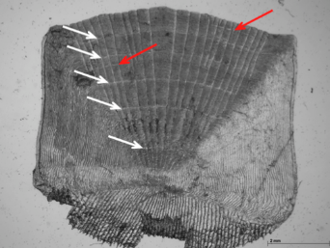
tblFish
fish_UID | fish_setUID | fish_sppUID | fish_length | fish_weight | fish_age | a1 | a2 | a3 | a4 | edge
1 | 1 | 1 | 210 | 254 | 4 | 178 | 223 | 381 | 413 | 413
2 | 1 | 1 | 243 | 222 | 4 | 145 | 242 | 335 | 481 | 490
3 | 2 | 1 | 135 | 86 | 2 | 195 | 284 |  |  | 292
4 | 3 | 2 | 142
5 | 4 | 3 | 138
6 | 5 | 3 | 179
7 | 6 | 1 | 198 | 168 | 3 | 188 | 254 | 365 |  | 365
8 | 7 | 4 | 854 | 355 | 4 | 113 | 241 | 384 | 476 | 484
9 | 8 | 4 | 686 | 321 | 3 | 105 | 289 | 349 |  | 349
10 | 9 | 5 | 312 | 211 |  |  |  |  |  | 230

Slide 102
tblFish
fish_UID | fish_setUID | fish_sppUID | fish_length | fish_weight | fish_age | fish_edge
1 | 1 | 1 | 210 | 254 | 4 | 413
2 | 1 | 1 | 243 | 222 | 4 | 490
3 | 2 | 1 | 135 | 86 | 2 | 292
4 | 3 | 2 | 142
5 | 4 | 3 | 138
6 | 5 | 3 | 179
7 | 6 | 1 | 198 | 168 | 3 | 365
8 | 7 | 4 | 854 | 355 | 4 | 484
9 | 8 | 4 | 686 | 321 | 3 | 349
10 | 9 | 5 | 312 | 211 |  | 230
 | fish_setUID | fish_sppUID | fish_length | fish_weight | fish_age | a1 | a2 | a3 | a4 | edge
 | 1 | 1 | 210 | 254 | 4 | 178 | 223 | 381 | 413 | 413
 | 1 | 1 | 243 | 222 | 4 | 145 | 242 | 335 | 481 | 490
 | 2 | 1 | 135 | 86 | 2 | 195 | 284 |  |  | 292
 | 3 | 2 | 142
 | 4 | 3 | 138
 | 5 | 3 | 179
 | 6 | 1 | 198 | 168 | 3 | 188 | 254 | 365 |  | 365
 | 7 | 4 | 854 | 355 | 4 | 113 | 241 | 384 | 476 | 484
 | 8 | 4 | 686 | 321 | 3 | 105 | 289 | 349 |  | 349
 | 9 | 5 | 312 | 211 |  |  |  |  |  | 230
tblAge
age_UID | age_fishUID | age_age | age_annulus
1 | 1 | 1 | 178
2 | 1 | 2 | 223
3 | 1 | 3 | 381
4 | 1 | 4 | 413
5 | 2 | 1 | 145
6 | 2 | 2 | 242
7 | 2 | 3 | 335
8 | 2 | 4 | 481
9 | 3 | 1 | 195
10 | 3 | 2 | 284
11 | 7 | 1 | 188
12 | 7 | 2 | 254
13 | 7 | 3 | 365
14 | 8 | 1 | 113
15 | 8 | 2 | 241
16 | 8 | 3 | 384
17 | 8 | 4 | 476
18 | 9 | 1 | 105
19 | 9 | 2 | 289
20 | 9 | 3 | 349

Slide 103
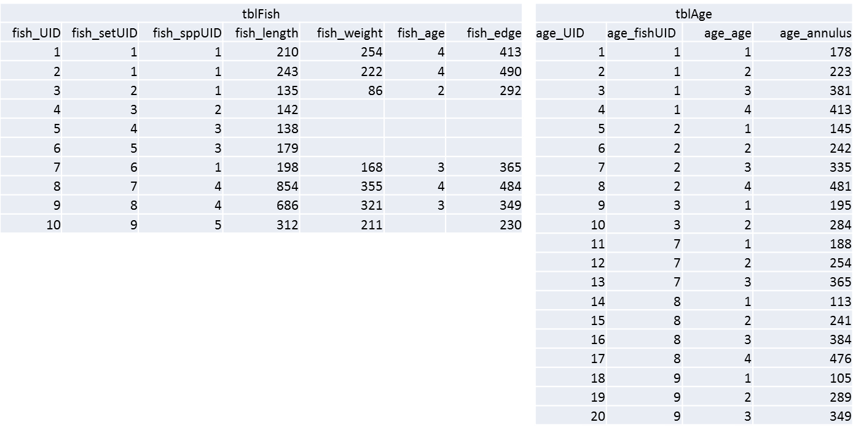
SELECT tblFish.fish_UID, tblAge.age_age, [Intercept]+([fish_length]-[Intercept])*([age_annulus]/[fish_edge]) AS LAA
FROM (tblSpecies INNER JOIN tblFish ON tblSpecies.spp_UID = tblFish.fish_sppUID) INNER JOIN tblAge ON tblFish.fish_UID = tblAge.age_fishUID;

Slide 104
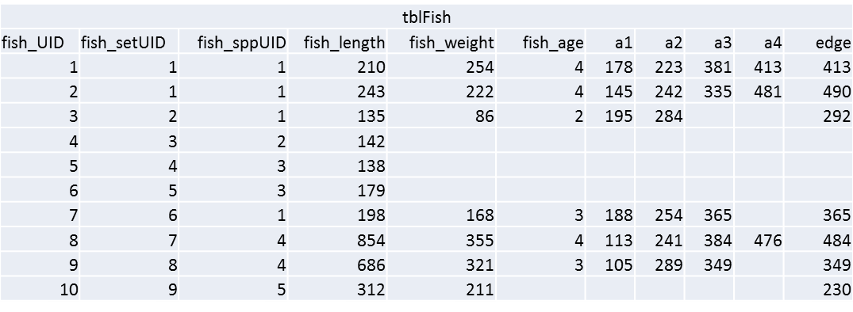
SELECT tblFish.fish_UID, tblAge.age_age, [Intercept]+([fish_length]-[Intercept])*([age_annulus]/[fish_edge]) AS LAA
FROM (tblSpecies INNER JOIN tblFish ON tblSpecies.spp_UID = tblFish.fish_sppUID) INNER JOIN tblAge ON tblFish.fish_UID = tblAge.age_fishUID;
SELECT tblFish.fish_UID, tblAge.age_age, [Intercept]+([fish_length]-[Intercept])*([age_annulus1]/[fish_edge]) AS LAA1, [Intercept]+([fish_length]-[Intercept])*([age_annulus2]/[fish_edge]) AS LAA2, [Intercept]+([fish_length]-[Intercept])*([age_annulus3]/[fish_edge]) AS LAA3, [Intercept]+([fish_length]-[Intercept])*([age_annulus4]/[fish_edge]) AS LAA4 FROM (tblSpecies INNER JOIN tblFish ON tblSpecies.spp_UID = tblFish.fish_sppUID) INNER JOIN tblAge ON tblFish.fish_UID = tblAge.age_fishUID;

Slide 105
SELECT tblFish.fish_UID, tblAge.age_age, [Intercept]+([fish_length]-[Intercept])*([age_annulus]/[fish_edge]) AS LAA
FROM (tblSpecies INNER JOIN tblFish ON tblSpecies.spp_UID = tblFish.fish_sppUID) INNER JOIN tblAge ON tblFish.fish_UID = tblAge.age_fishUID;
SELECT tblFish.fish_UID, tblAge.age_age, [Intercept]+([fish_length]-[Intercept])*([age_annulus1]/[fish_edge]) AS LAA1, [Intercept]+([fish_length]-[Intercept])*([age_annulus2]/[fish_edge]) AS LAA2, [Intercept]+([fish_length]-[Intercept])*([age_annulus3]/[fish_edge]) AS LAA3, [Intercept]+([fish_length]-[Intercept])*([age_annulus4]/[fish_edge]) AS LAA4, [Intercept]+([fish_length]-[Intercept])*([age_annulus5]/[fish_edge]) AS LAA5, [Intercept]+([fish_length]-[Intercept])*([age_annulus6]/[fish_edge]) AS LAA6, [Intercept]+([fish_length]-[Intercept])*([age_annulus7]/[fish_edge]) AS LAA7, [Intercept]+([fish_length]-[Intercept])*([age_annulus8]/[fish_edge]) AS LAA8, [Intercept]+([fish_length]-[Intercept])*([age_annulus9]/[fish_edge]) AS LAA9, [Intercept]+([fish_length]-[Intercept])*([age_annulus10]/[fish_edge]) AS LAA10 FROM (tblSpecies INNER JOIN tblFish ON tblSpecies.spp_UID = tblFish.fish_sppUID) INNER JOIN tblAge ON tblFish.fish_UID = tblAge.age_fishUID;

Slide 106
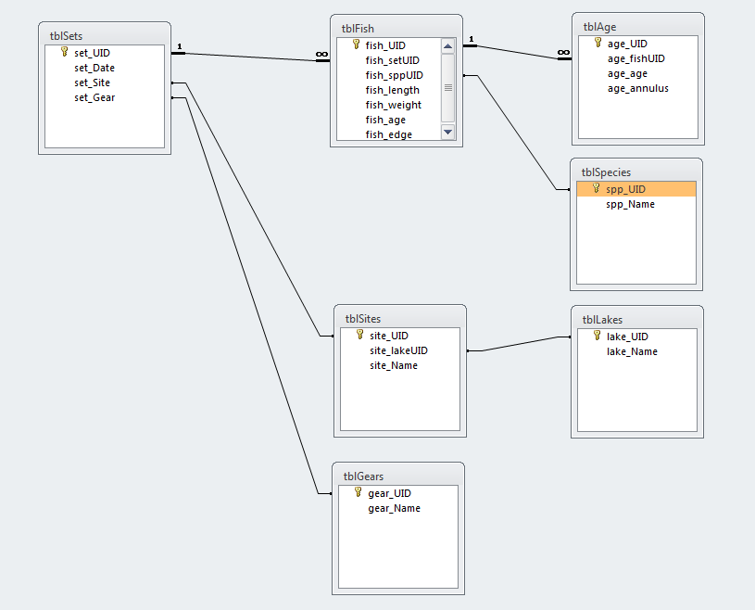

Slide 109
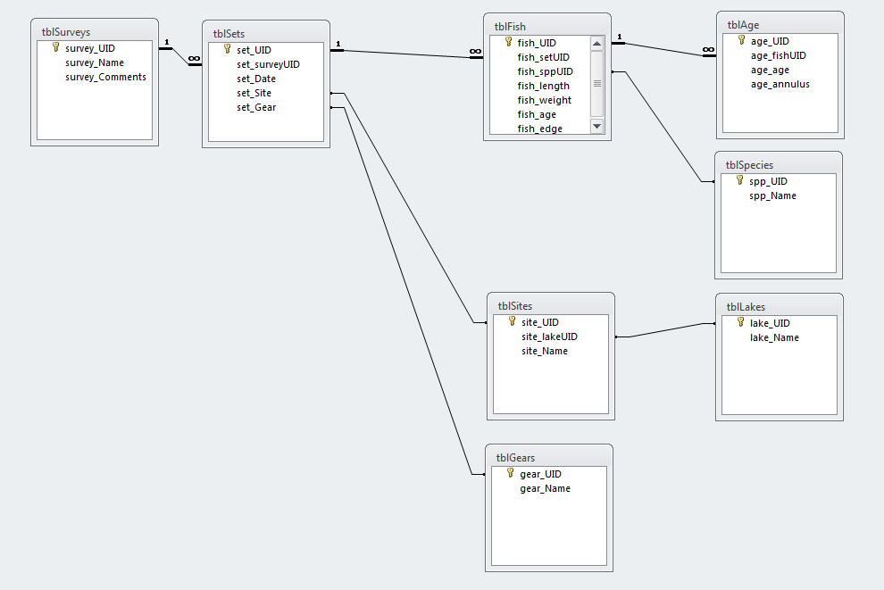

Slide 110
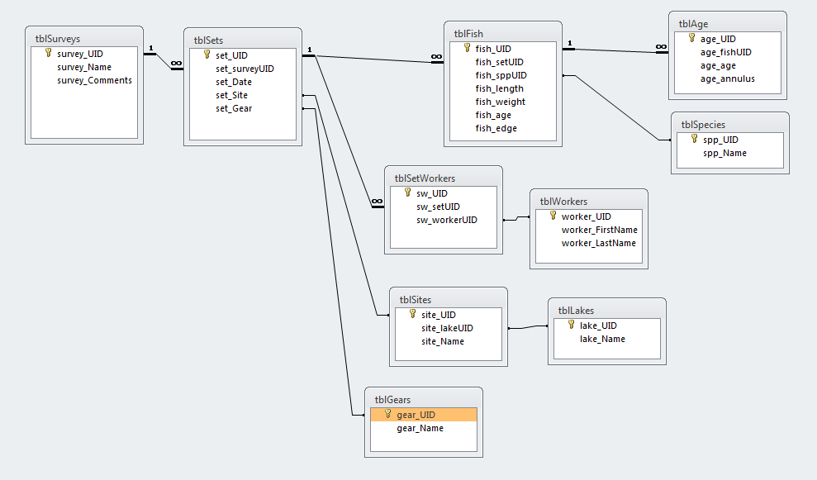

Slide 111
Two More Steps:
Label Required Fields
Label Data Types

Slide 112
Data types
Text fields
text vs memo
text vs number
empty string vs null
Date/time fields
Boolean/bit fields
Integer/Double/Decimal
Specialty Fields

Slide 113
Data type | Description | Storage
Text | Use for text or combinations of text and numbers. 255 characters maximum
Memo | Memo is used for larger amounts of text. Stores up to 65,536 characters. Note: You cannot sort a memo field. However, they are searchable
Byte | Allows whole numbers from 0 to 255 | 1 byte
Integer | Allows whole numbers between -32,768 and 32,767 | 2 bytes
Long | Allows whole numbers between -2,147,483,648 and 2,147,483,647 | 4 bytes
Single | Single precision floating-point. Will handle most decimals | 4 bytes
Double | Double precision floating-point. Will handle most decimals | 8 bytes
Currency | Use for currency. Holds up to 15 digits of whole dollars, plus 4 decimal places. Tip:You can choose which country's currency to use | 8 bytes
AutoNumber | AutoNumber fields automatically give each record its own number, usually starting at 1 | 4 bytes
Date/Time | Use for dates and times | 8 bytes
Yes/No | A logical field can be displayed as Yes/No, True/False, or On/Off. In code, use the constants True and False (equivalent to -1 and 0). Note: Null values are not allowed in Yes/No fields | 1 bit
Ole Object | Can store pictures, audio, video, or other BLOBs (Binary Large OBjects) | up to 1GB
Hyperlink | Contain links to other files, including web pages

Slide 114
Performance
Primary Keys
Indexes
Stored Procedures/Views

Slide 115
To Do
Create Lookup Tables To Remove Text
Split Out Sets Of Fields That Repeat Down Columns
Transpose columns to rows where possible
Goals
Each row represents one and only one piece of meaningful data
Each piece of data is in only one place
No data is in field headers
In production, you can add rows and not columns

Slide 116
I’ve Learned So Much From My Mistakes…
I’m Thinking Of Making A Few More
Notes:
We’ve all made mistakes
Share one of mine.

Slide 117

Lets Make A Database!

Slide 118

Any Problems?

Slide 119


Slide 120


Slide 121


Slide 122
Queries and SQL
Notes:
Use access to show how to design a database
Good design means
simpler queries
better performance
less data entry
easier to add data fields without breaking backwards compatibility
Think of records as an “entity”…and then “sets” of entities”

Slide 123
CRUD Queries
Create
Update
Delete

Slide 124

Select A From B Where C
Select set_date From tblSets Where set_gear = 1

Slide 125



Keith Hurley
keith.hurley@Nebraska.gov

